Slide 1


Nayeli Rocha
07 /November/ 2023

Slide 2

Outline
Executive Summary
Introduction
Methodology
Results
Conclusion
Appendix

Slide 3
Executive Summary
Space Y a new rocket company would like to compete with SpaceX , which launches its Falcon 9 rocket for $62 million. Space Y has hired a data scientist to identify the factors for a successful rocket landing, compute the rate of successful landings over time and built a model to predict whether Space X Falcon 9 first stage will land successfully. To achieve the objectives, the data scientist follow the next methodology:
Data collection. SpaceX launch data was gathered from an API, requesting the data specifically from SpaceX REST API by the get request () method, and the Falcon 9 Launch data Wiki pages, using web-scrapping methodology
Wrangling data: .once with the raw data from the previous step; throughout wrangling the raw data using an API, sampling data, and dealing with Nulls the raw dataset was transformed into a clean dataset which provides meaningful data such as create a Boolean success/fail landing variable.
Explore the processed data, throughout:
EDA. Considering the following features: PayloadMass, LaunchSite, FlightNumber, Orbit Type, and yearly trend, success rate.

Slide 4
Executive Summary
SQL skills, calculating the total payload range for successful rates, and total number of successful and failed outcomes.
4. Basic statistical analysis, data visualization and Dashboards. To see how variables might be related to each other and launch sites proximity to geographical markers
5. Build, evaluate, and refine predictive models, splitting the data into categorical variables , training data and test data to predict landing outcomes finding the best hyperparameters for SVM, classification Tree, Logistic regression and K-nearest neighbor.
Results:
- For launch Sites CCAFS SLC 40 & KSC LC 39A, as the FlightNumber increases, the first stage is more likely to land successfully.
- Launch success has improved over time.
- CCA FSL LC-40 and CCAFS SLC-40 are near the equator, and all sites are located near the coast,
- Launches with a payloadmass range between 2000kg and 5000 kg tended to reach a success landing
- All models performed similar on the test-set, however, classification tree slightly outperformed.

Slide 5
Introduction
Today, companies are trying to make space travel affordable for everyone. One of the most successful is SpaceX, which announces on its website launches of the Falcon 9 rocket for $62 million; other companies cost upwards of 165 million dollars each. Much of the savings is because SpaceX can reuse the first stage. Therefore, by knowing whether the first stage will land, it is possible to determine the cost of a launch. This information can be used if an alternate company wants to bid against SpaceX for a rocket launch.
A new rocket company, called SPACE Y, would like to compete with SpaceX.

Slide 6
Introduction
As a data scientist working for SPACE Y, it is important to identify and determine the factors for a successful rocket landing price of each launch. Therefore, using the Space X data, the following objectives should be covered in this capstone project:
Which factors or features are correlated with a landing success.
Rate of successful landings over time
Predict whether Space X Falcon 9 first stage will land successfully.

Slide 7

Section 1

Slide 8
Methodology
Executive Summary
Data collection methodology:
The SpaceX launch data was gathered from:
A SpaceX API, throughout a get request to the SpaceX REST API:
The Falcon 9 Launch data Wiki pages, throughout the Web Scrapping Method:
Perform data wrangling
To provide meaningful data, the data was cleaned performing: Wrangling Data using an API, Sampling Data, and Dealing with Nulls.
Perform exploratory data analysis (EDA) using visualization and SQL
To predict if the Falcon9 first stage will land successfully.

Slide 9
Methodology
Executive Summary
Perform interactive visual analytics using Folium and Plotly Dash
Perform predictive analysis using classification models
Classification Models were built to predict landing outcomes, then those models were evaluated to find the best parameters and identify the best models according accuracy and test_accuracy.

Slide 10
Data Collection - SpaceX API
Data was collected from the SpaceX REST API.
It was performed a get request to obtain the launch data.
The data collection process is presented in the Flowchart
Import libraries
Def. Auxiliary Functions
Request, Parse SpaceX
Data
getBoosterVersion: Booster name, getLaunchSite: name of the launch site, longitude, and latitude; getPayloadData: mass of the payload and the orbit; getCoredata: outcome of the landing, landing and core information.
Pandas dataframe
Decode the response content as a Json using, . Json()
Convert the json result into a dataframe with the .json_normalize method
Filter dataframe
Requests, pandas, numpy, datetime
Help us use the API to extract information using identification numbers in the launch data:
Remove the Falcon 1 launches, only keep the Falcon 9 launches.
Save the, filtered data to a new dataframe
Data Wrangling: Missing values
Make the requested JSON results more consistent, use the static response object: Statistic_json_url
Response= requests . get (spacex_url)
GitHub URL: https://github.com/Nayero/Space-X-Capstone-Project/blob/main/data-collection-API.ipynb

Slide 11
Data Collection - Scrapping
It was used Python BeautifulSoup package to web scrape HTML tables that contain Falcon 9 launch records.
The data collection process is presented in the Flowchart
Import packages , libraries
Request Falcon9 Launch
date_time; booster_versión; landing_status; get_mass; extract_column_from_header
Beautifulsoup4, requests, sys, re, unicodedata, pandas
Help us to process web scraped HTML table:
Def. helper functions
Create dataframe
Perform an HTTP GET method to request the Falcon9 Launch HTML page
Create a BeautifulSoup object
Find the target table
Create an empty dictionary with keys from the extracted column names
Extract column name applying extract_column_from_header ( )
Fill up the `launch_dict` with launch records extracted from table rows
Create a dataframe from launch_dict
GitHub URL : https://github.com/Nayero/Space-X-Capstone-Project/blob/main/Data%20collection%20webscraping.ipynb

Slide 12
Data Wrangling - using an API
Some columns, have an ID number, not actual data.
Therefore, the API target another endpoint to gather specific data for each ID number
Dataframe
Subset
Create a dictionary
Using the data obtained, combine the columns into a dictionary.
Call the auxiliary funtions: getBoosterVersion (data), getLaunchSite(data), getPayload(data), getCoredata(data)
Pandas dataframe
From the dictionary create a dataframe using .DataFrame (dictionary)
Filter dataframe
Keep only the wanted features: rocket, payloads, launchpad, cores.
Help us use the API to extract information using identification numbers in the launch data:
Remove the Falcon 1 launches, only keep the Falcon 9 launches.
Save the, filtered data to a new dataframe
Data Wrangling: Missing values
Store the data in empty lists and use them to create a new dataframe
Apply auxiliary functions
GitHub URL: https://github.com/Nayero/Space-X-Capstone-Project/blob/main/data-collection-API.ipynb

Slide 13
Data Wrangling - Dealing with Nulls
Some columns, have missing values. To deal with missing values follow the flowchart.
Identify Nulls
Calculate the
mean( )
To determine if the dataset has missing values, it is used the .isnull().sum() function.
Calculate the mean of the column with missing values; df [‘column’]. mean ( )
Replace the np.nan values with its mean value; [‘Column'].replace (np.nan, mean)
GitHub URL: https://github.com/Nayero/Space-X-Capstone-Project/blob/main/data-collection-API.ipynb

Slide 14
Data Wrangling
The collected data, once was analyzed and summarized features, it was improved by creating a landing outcome label
Import libraries
Data Analysis
Launches each site
Calculate the number of launches on each site with the method value_counts() on column LaunchSite: df['LaunchSite'].value_counts()
Ocurrence e
Orbit
Pandas, numpy
Load SpaceX dataset
Identify and calculate the % of missing values in each column.
Identify which columns are numerical and categorical
Apply value_counts on Orbit column: df['Orbit'].value_counts()
Landing outcomes
Landing_outcomes = values on Outcome column: landing_outcomes=df['Outcome'].value_counts()
Outcome label
Create a landing outcome label from Outcome column
Create a list where the element is zero if the first stage did not land successfully; one means the first stage landed Successfully.
Assign it to the variable called Landing_Class
GitHub URL: https://github.com/Nayero/Space-X-Capstone-Project/blob/main/Data%20wrangling.ipynb

Slide 15
EDA with Data Visualization
Summarize what charts were plotted and why you used those charts
Chart Plotted | Features plotted | Reason
Scatter plot | FlightNumber vs PayloadMass | To visualize how those features would affect the launch outcome
Scatter plot | FlightNumber vs. FlightNumber | Visualize the relationship between features
Scatter plot | PayloadMass vs. FlightNumber | Visualize if there is any relationship between features
Bar chart | Success rate of each orbit type | Visualize if there are any relationship between success rate of each orbit type
Scatter plot | FlightNumber vs. Orbit type | To see if there is any relationship between FlightNumber and Orbit type.
Scatter plot | Payload vs. Orbit type | Visualize the relationship between Payload and Orbit type
Line plot | Year vs. average launch success | Visualize the launch success yearly trend
GitHub URL: https://github.com/Nayero/Space-X-Capstone-Project/blob/main/EDA-datavisualization.ipynb

Slide 16
EDA with SQL
Load the Spacex dataset and save it as .cvs file.
Load the SQL extension and establish a connection with the database.
Summarize the SQL queries you performed.
3.1 Display the names of the unique launch sites in the space mission.
3.2 Display 5 records where launch sites begin with the string ‘CCA’
3.3 Display the total payload mass carried by boosters launched by NASA (CRS)
3.4 Display average payload mass carried by booster version F9 v1.1
3.5 List the names of the boosters which have success in drone ship and have payload mass greater than 4000 but less than 6000
3.6 List the total number of successful and failure mission outcomes
3.7 List the names of the booster_versions which have carried the maximum payload mass. Use a subquery
3.8 List the records which will display the month names, failure landing_outcomes in drone ship ,booster versions, launch_site for the months in year 2015.
3.9 Rank the count of landing outcomes (such as Failure (drone ship) or Success (ground pad)) between the date 2010-06-04 and 2017-03-20, in descending order.
GitHub URL: https://github.com/Nayero/Space-X-Capstone-Project/blob/main/EDA-sql.ipynb

Slide 17
Build an Interactive Map with Folium
1. The launch Sites were marked with circles on the its specific coordinates (Latitude and Longitude) and a popup label:
Blue Circles at Nasa Johnson Space Center
Orange Circles at all launch sites.
2. Launch Outcomes were marked at each launch site, to indicate which launch site have high success rates:
Green colored cluster marker to indicate successful launches
Red Colored cluster marker to indicate unsuccessful launches
3. The distances between the CCAFS SLC-40 Launch Site and its proximities were marked with blue Polylines
GitHub URL: https://github.com/Nayero/Space-X-Capstone-Project/blob/main/Launch_site_location_Folium.ipynb

Slide 18
Build a Dashboard with Plotly Dash
Plots/Graphs /Charts
Pie plot ´to visualize the share of successful launches of each launch site, to illustrate the numerical proportion of successful and unsuccessful launches per launch site
Scatter plot to identify if there is any correlation between PayloadMass vs. Success Rate by Booster version
Interactions
Dropdown list with Launch sites, allowing users to select either all launches at once or a unique launch site.
Slider of Payload Mass Range, allowing users to select a certain Payload Mass range to apply on the scatterplot.
GitHub URL:

Slide 19
Predictive Analysis (Classification)
Build the Model
Evaluate and Improve the Model
Calculate accuracy on the test data using .score()
Improved the model
using algorithm tuning
Assess the confusion matrix
for all models
Identify
best performing classification model
NumPy Array Create from the class column a Numpy Array
Standardize
Fit and transform the data with StandardScaler
Assess the GridSearchCv on different algorithms
Split the data using train_test_split
GridSearchCv object with cv=10 for parameter optimization
GitHub URL: https://github.com/Nayero/Space-X-Capstone-Project/blob/main/SpaceX_Machine_Learning_Prediction.ipynb

Slide 20
Results
Exploratory data analysis results
Launch success rate has increased overtime.
As the FlightNumber increases, the first stage is more likely to land successfully
In overall, KSC LC-39A has the highest success rate among landing sites. Moreover; it recorded 100% success rate for launches with PayloadMass less than aprox 5,500Kg:
Most launches sites with a PayloadMass 7000Kg recorded successful landings in first stage.
Orbits ES-L1, GEO, HEO, and SSO (SO) have 100% success rate: The success rate for each orbit tend to be increase as the FlightsNumber increases. However, for GTO orbit is hard to follow a trend.
Interactive analytics demo in screenshots
KSC LC 39 -A Launch site had the highest launch success ratio (76.9%)
Launch sites do not represent a risk for humans due to are close to the coast and not close to highways, cities and railways
Payloads between 2000 Kg and 5000 kg shown the highest success rate.
Predictive analysis results
Decision tree model is the best predictive model for the dataset.

Slide 21

Section 2

Slide 22
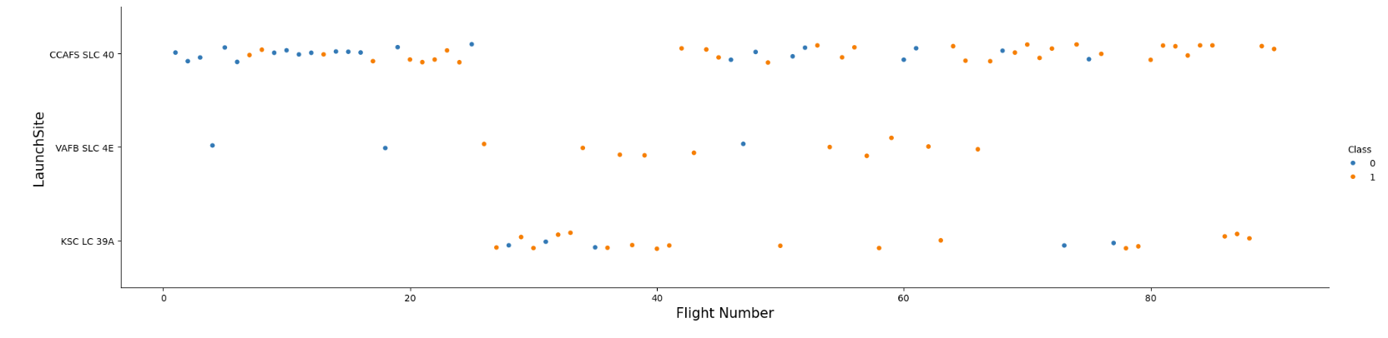
Flight Number vs. Launch Site
Show a scatter plot of Flight Number vs. Launch Site
For launchSites CCAFS SLC 40 & KSC LC 39A, as the flight number increases, the first stage is more likely to land successfully.
On the other hand, when FlightNumbers are lower than 20: CCAFS SLC 40 tended to fail, and there are no launches from KSC LC.
For the VAFB-SLC launchSite there are no rockets launches for FlightNumbers greater than 70.

Slide 23
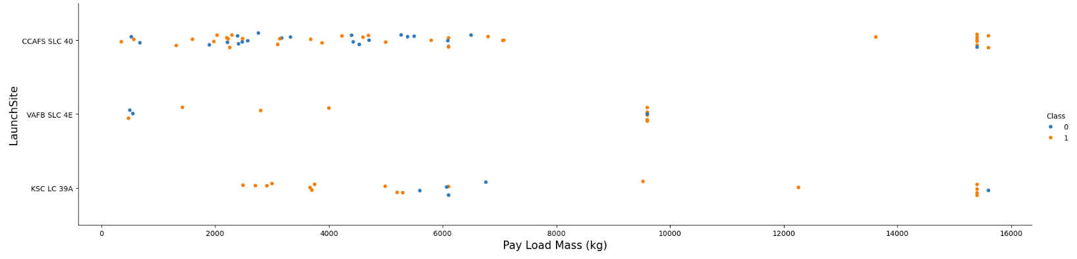
Payload vs. Launch Site
Show a scatter plot of Payload vs. Launch Site
In the VAFB-SLC launchsite, there are no rockets launched for PayloadMass greater than 10000.
Payloads that approach MAX(Payload) tended to launch successfully from CCAFS SLC 40 & KSC LC 39A
Payloads less than 8000 kg tended to fail at a higher rate when launched from CCAFS SLC 40
KSC LC 39A has a 100% success rate for launches less than aprox 5500Kg

Slide 24
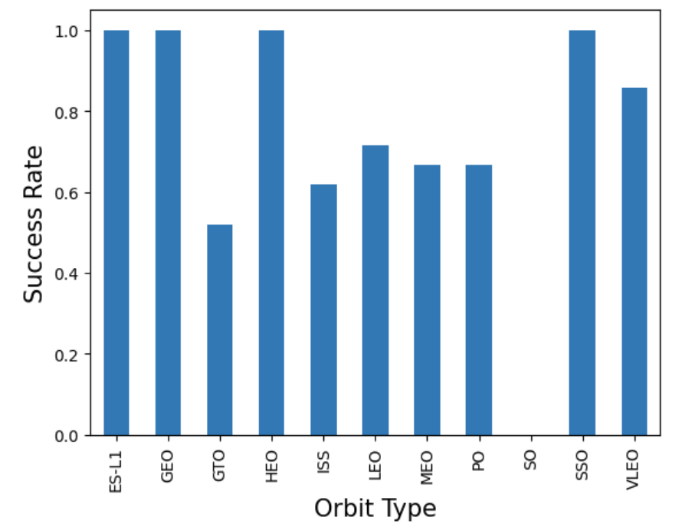
Success Rate vs. Orbit Type
Show a bar chart for the success rate of each orbit type
The orbits with higher success rate are ES-L1, GEO, HEO, SSO or SO.
GTO is the orbit with lower success rate.

Slide 25
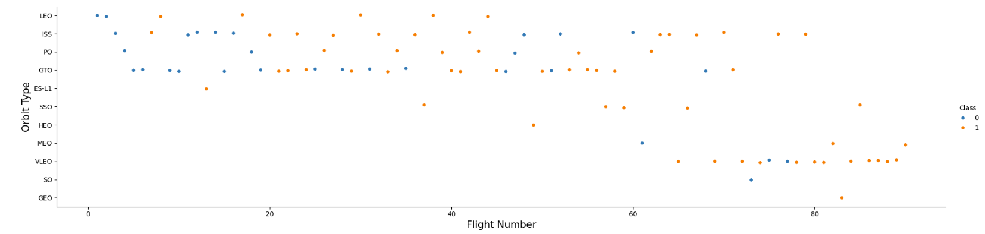
Flight Number vs. Orbit Type
Show a scatter point of Flight number vs. Orbit type
For most orbits, as the FlightNumber increases, the landing success rate for each orbit also increases. This is evident in the Leo Orbit. Not the case for GTO orbit, which seems to not follow this trend.

Slide 26
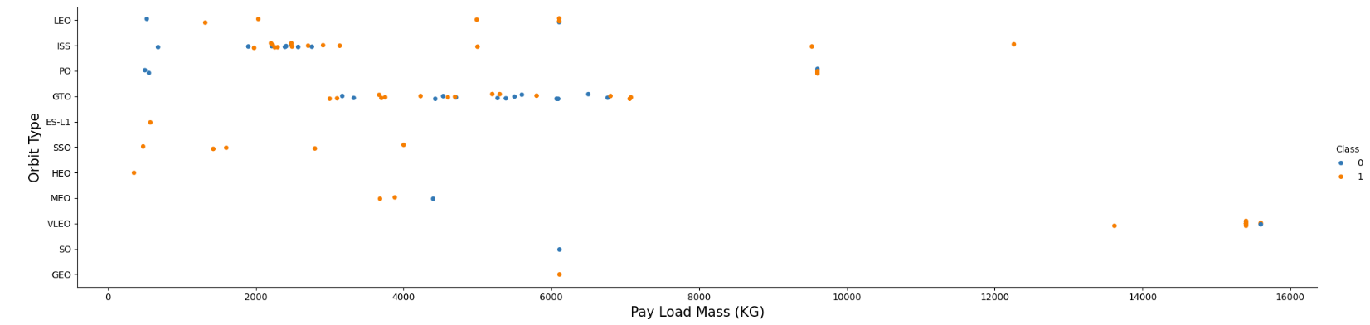
Payload vs. Orbit Type
Show a scatter point of payload vs. orbit type
With heavy payloads the successful landing or positive landing rate is higher for Polar, LEO and ISS orbits
However, for GTO cannot distinguish this well, as both positive landing rate and negative landing (unsuccessful mission) are both there.

Slide 27
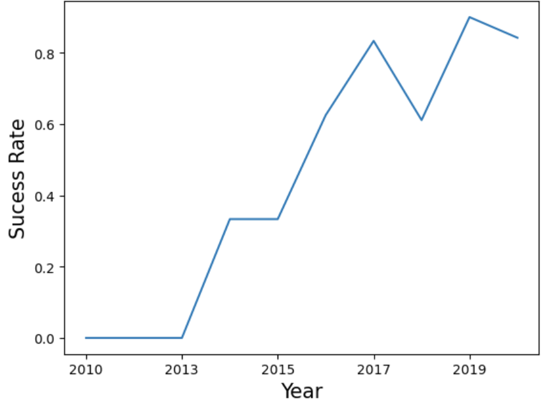
Launch Success Yearly Trend
Show a line chart of yearly average success rate
Although the success rate from 2017 to 2018 decreased. Since 2013, the landing success rate kept increasing till 2020.

Slide 28
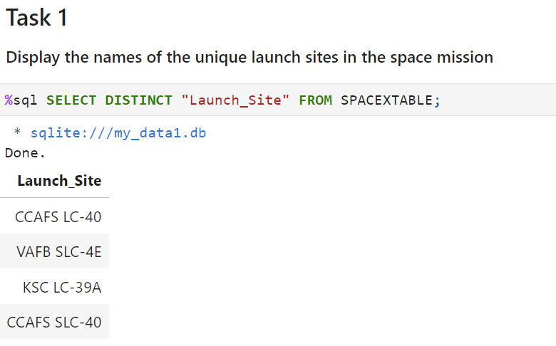
All Launch Site Names
Find the names of the unique launch sites
The query was made using the Distinct function to obtain the unique launch sites name

Slide 29
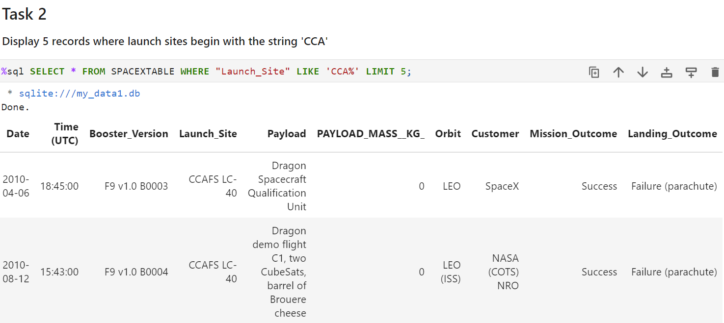
Launch Site Names Begin with 'CCA'

Slide 30
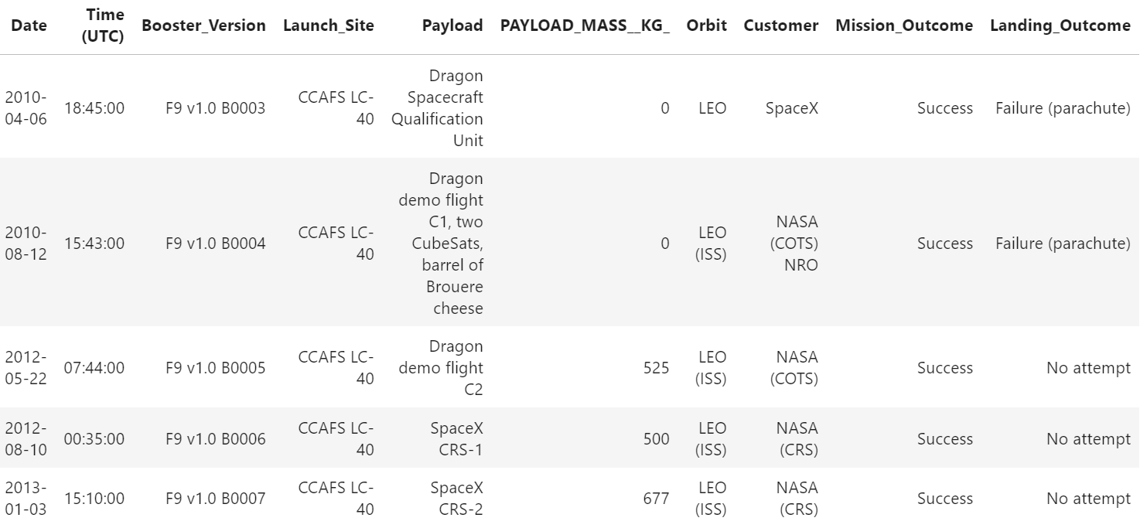
Launch Site Names Begin with 'CCA'
Display 5 records where launch sites begin with the string 'CCA'
In the query we used the like function to filter the launch sites names that start with CCA and limit the results to the first 5 rows.

Slide 31
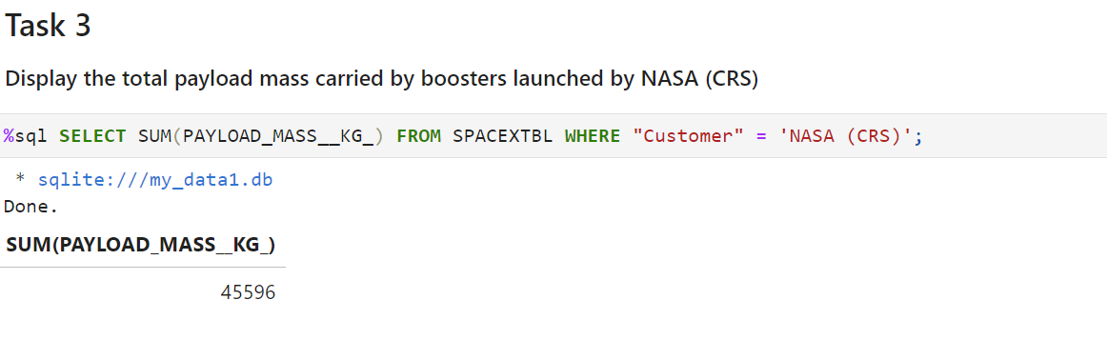
Total Payload Mass
Calculate the total payload carried by boosters from NASA
The total PayloadMass was conditioned to be carried by boosters from (CRS), therefore we used the where function with this parameter.

Slide 32
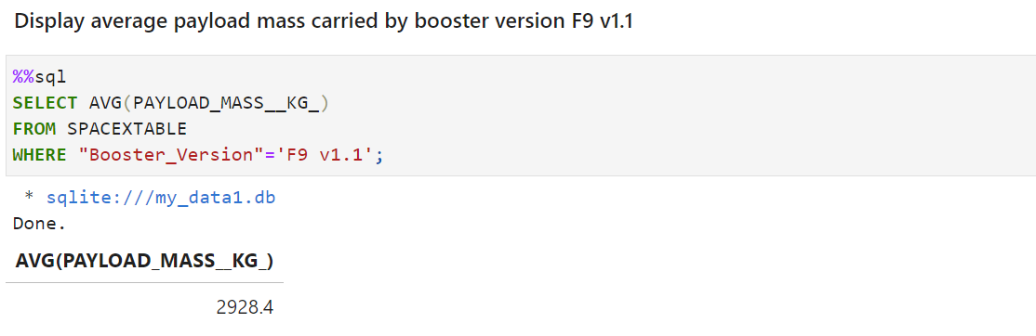
Average Payload Mass by F9 v1.1
Calculate the average payload mass carried by booster version F9 v1.1
The average PayloadMass was conditioned to be carried by booster version F9 v1.1 therefore we used the where function with this parameter.

Slide 33
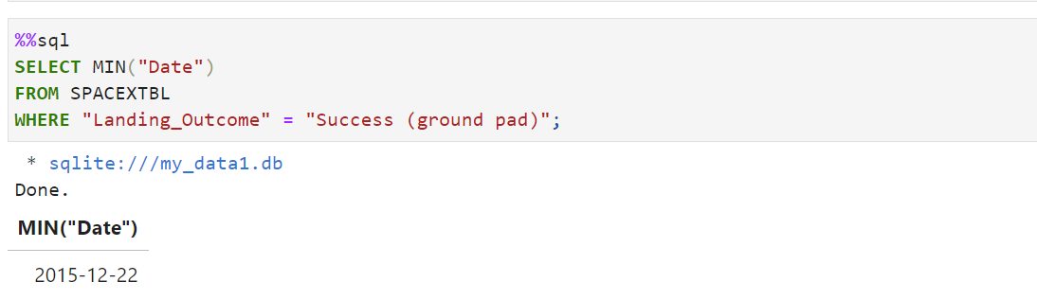
First Successful Ground Landing Date
Find the dates of the first successful landing outcome on ground pad
The query was made using success landing_outcome on ground pad as parameter in the where function to filter the first successful Ground landing date

Slide 34
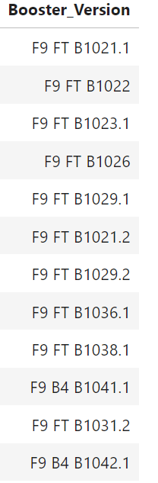
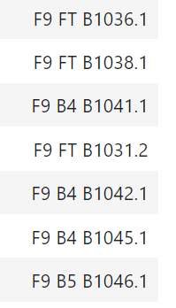
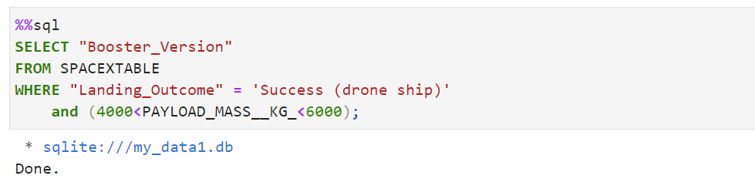
Successful Drone Ship Landing with Payload between 4000 and 6000
List the names of boosters which have successfully landed on drone ship and had payload mass greater than 4000 but less than 6000
Present your query result with a short explanation here
The query was made using two conditions as parameter success landing_outcome on drone ship and a specific payloadmass range as parameters

Slide 35
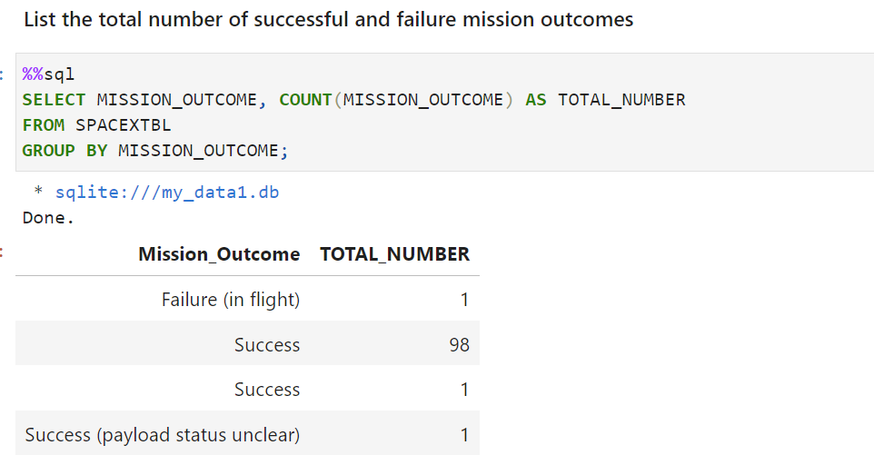
Total Number of Successful and Failure Mission Outcomes
Calculate the total number of successful and failure mission outcomes
The query used groupby function to get the total number of Mission outcomes per successful and failure classification

Slide 36
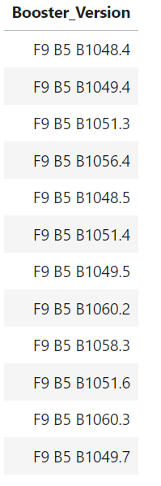
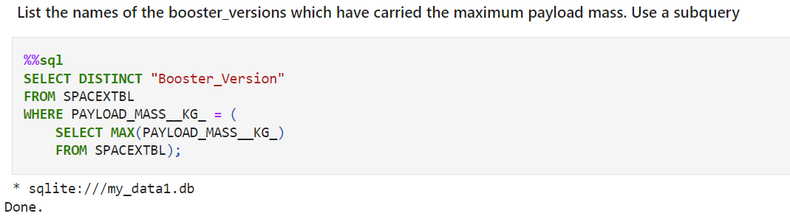
Boosters Carried Maximum Payload
List the names of the booster which have carried the maximum payload mass
Present your query result with a short explanation here

Slide 37
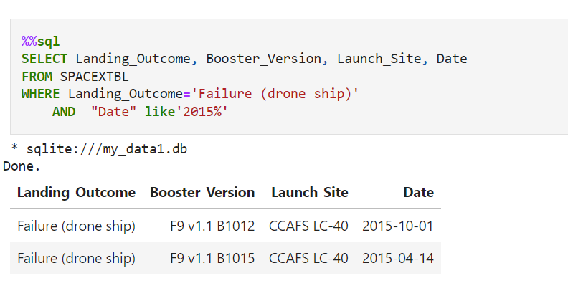
2015 Launch Records
List the failed landing_outcomes in drone ship, their booster versions, and launch site names for in year 2015
The query was made considering the conditions failure drone ship lainding_outcome in the year 2015

Slide 38
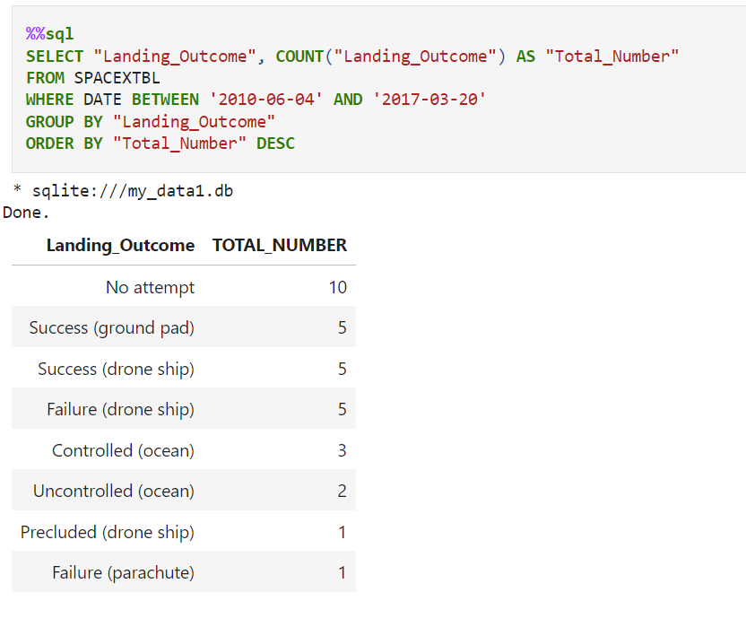
Rank Landing Outcomes Between 2010-06-04 and 2017-03-20
Rank the count of landing outcomes (such as Failure (drone ship) or Success (ground pad)) between the date 2010-06-04 and 2017-03-20, in descending order
Present your query result with a short explanation here
The query used the groupby function to get the landing_Outcome records classified by by success and failure, then we used the DESC function to make the rank

Slide 39

Section 3

Slide 40
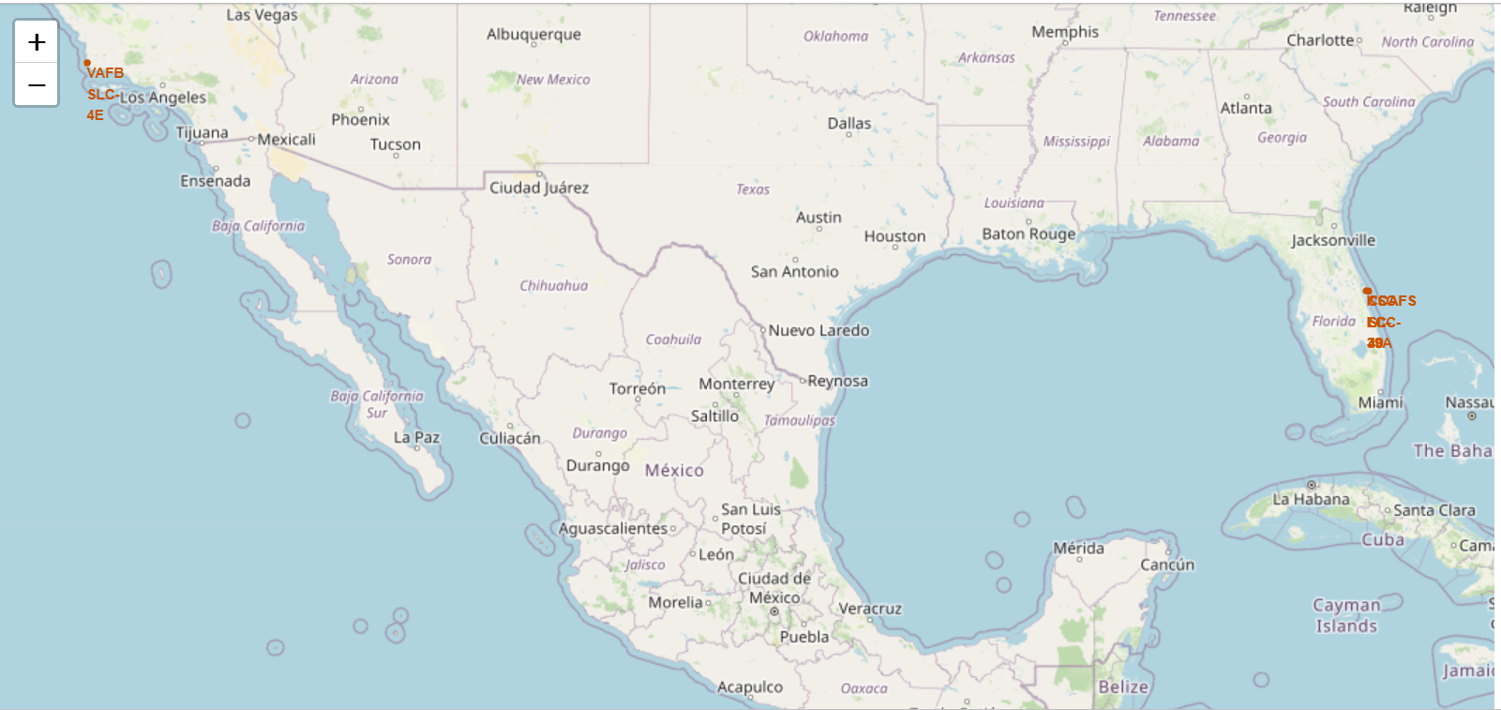
Folium map - Launch Sites locations
Overall, all the launch sites are close to the coast, but VAFBSLC – 40 launch site has a very close proximity to the coast.
The Launch sites are close to the Equator line, so their locations make easier to launch to the equatorial orbit

Slide 41
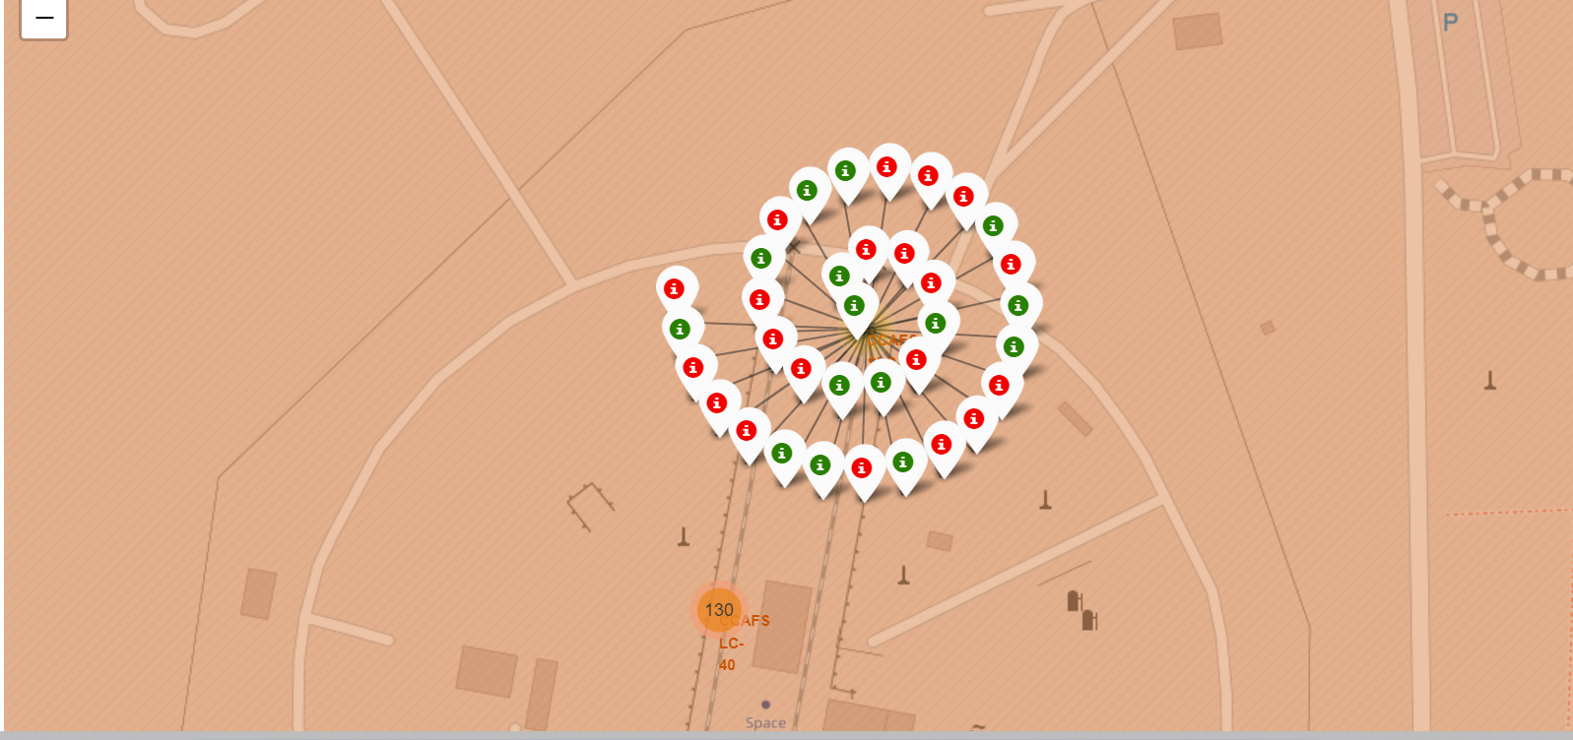
Folium Map - Launch Outcomes
CCAFS SLC-40 launch Site has 42.8% success rate (15/35)
CCAFS LC-40 has a 26.9.% success rate (35/130 )
The green markets indicates a successful launch (class=1)
The red markers indicates an unsuccessful launch (class=0)

Slide 42
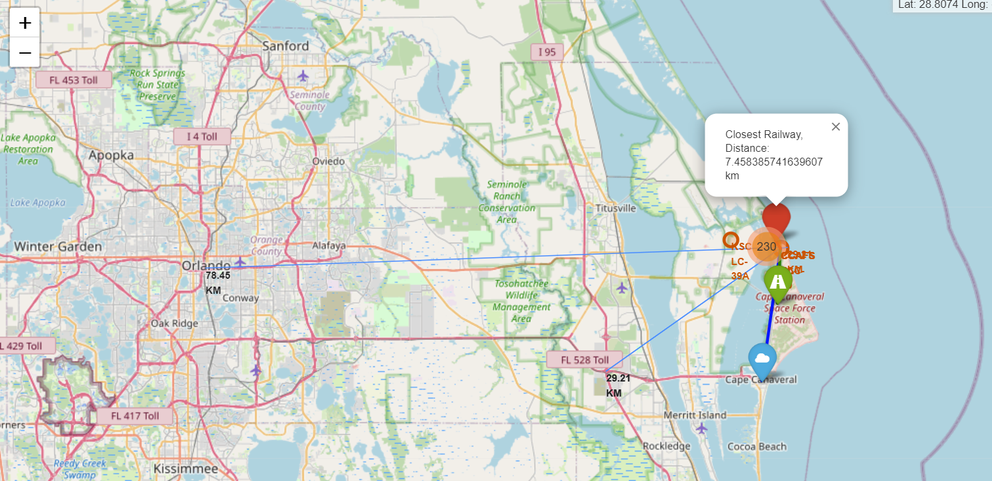
Folium Map - Distance to Proximities
CCAFS LC- 40 distances to:
Closest railway is 7.45 Km
Closest city is 18.18 km
Closest Highway: 1.35 km
Closest coastline is 29.21 km

Slide 43

Section 4

Slide 44
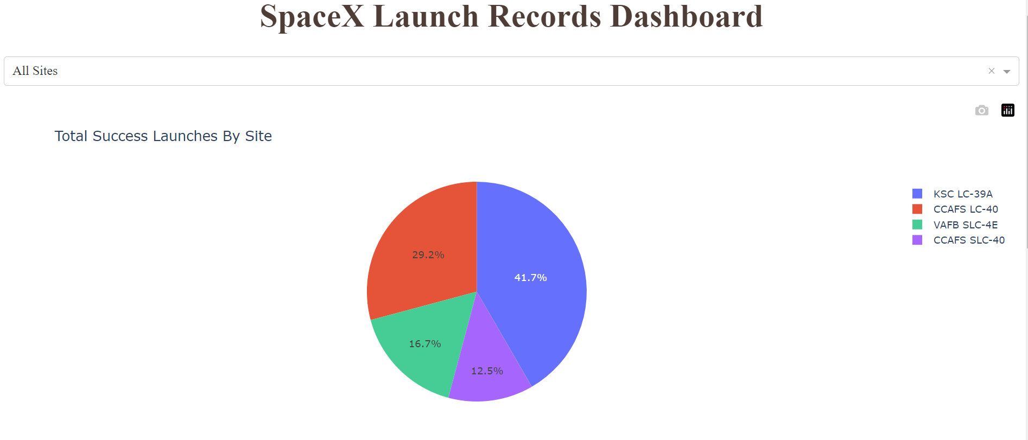
Dashboard – Launch Success
The pie chart describe the success rate count per launch site.
As is shown in the pie chart, KSC LC 39A has the most successful launches percentage (41.2%), followed by with …

Slide 45
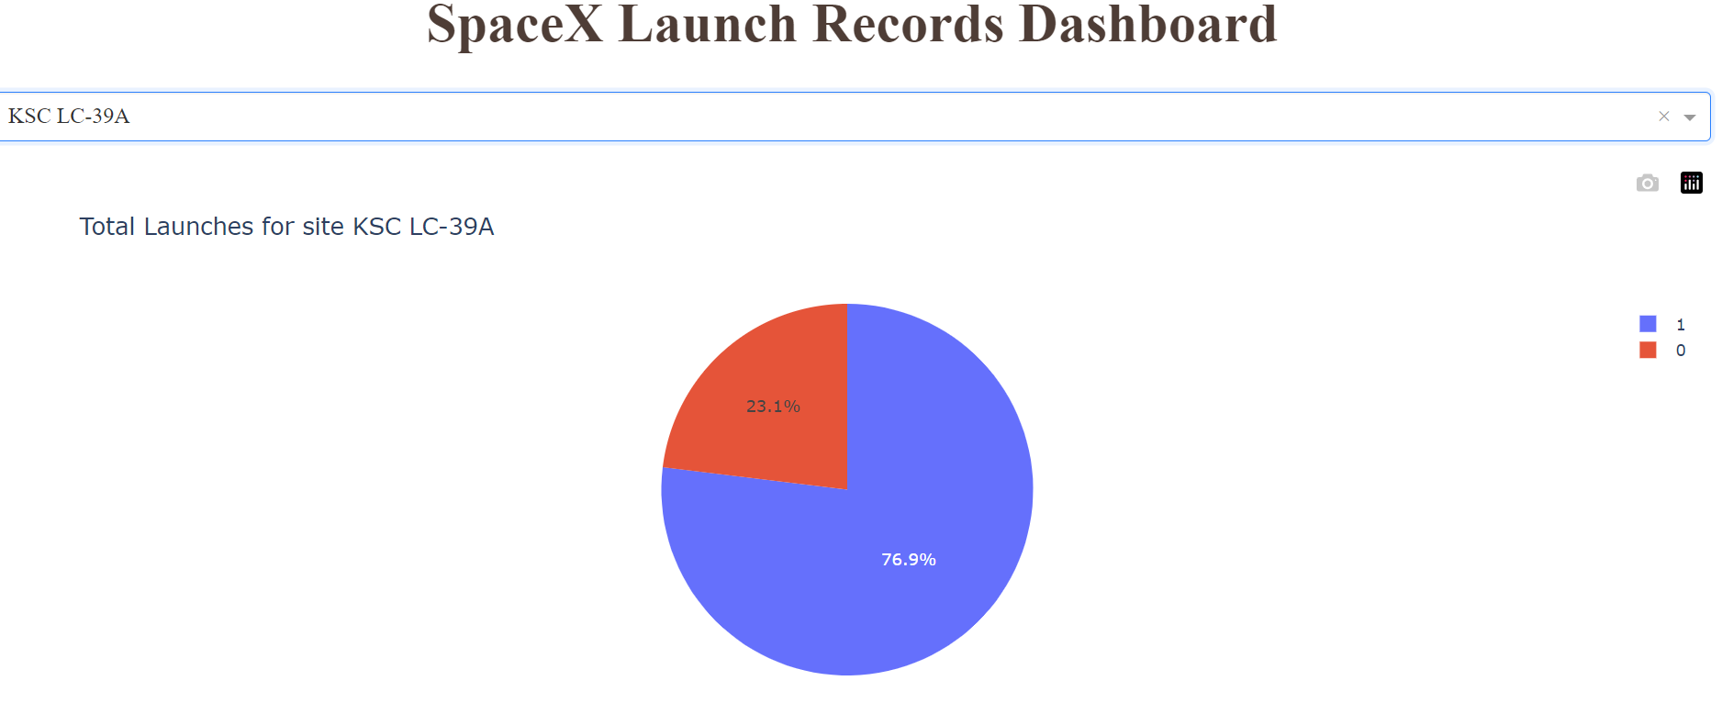
Dashboard – Launch Success (KSC LC-39A)
The pie chart shown the launch site with the highest success counts, in this case KSC LC-39A. This launch site has the success rate of 76.9%)

Slide 46
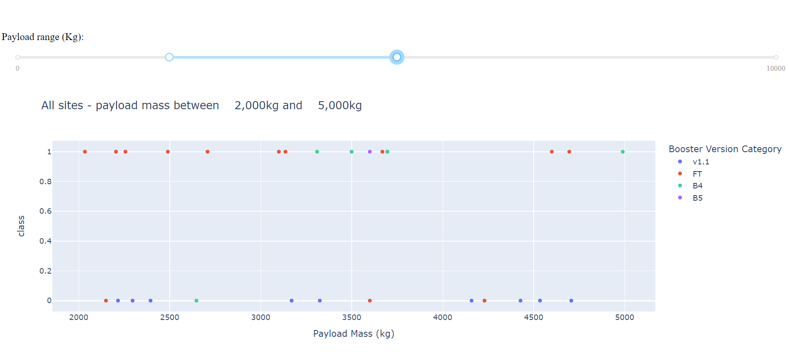
Dashboard - Payload vs. Launch Outcome
The scatter plot shown how the payload is correlated with the Launch Outcome.
Payloads between 2000 Kg and 5000 kg shown the highest success rate

Slide 47

Section 5

Slide 48
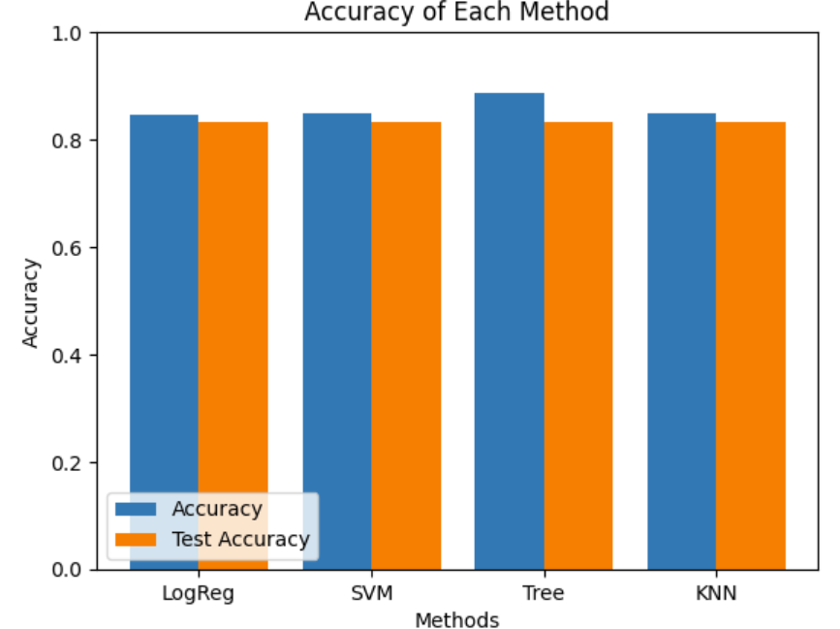
Classification Accuracy
The model with the highest classification accuracy is the Decision Tree Model, which slightly outperformed when looking at .best_score_ with 0.8857. However, all the models performed with same test- accuracy results

Slide 49
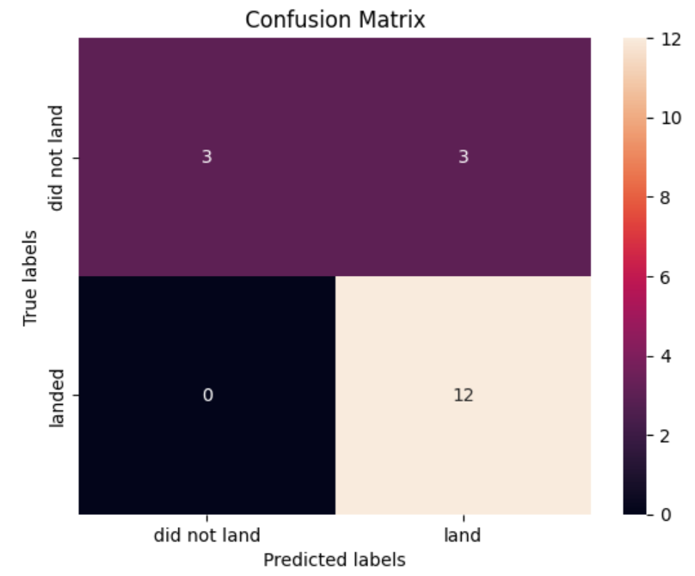
Confusion Matrix
All the confusion matrix were identical, all presented Type 1 error:
3 True negative
3 False positive (type 1 error)
0 false negative
12 True Positive

Slide 50
Conclusions
It is concluded:
- FlightNumbers and Payloads are correlated with landing success rate.
- Launch success rate kept improved from 2013 to 2019
- Orbits GEO, LEO, SSO had the most success rate.
- KSC LC- 39A had the most successful launches among all launch sites.
- Launches with a Payload mass range between 2000kg and 5000 kg tended to reach a success landing
- The classification Tree is the best machine learning algorithm to predict landing outcomes.

Slide 51


